Slide 1
SAP BTP Extension Suite Training
Day 11
Anubhav Oberoy
www.AnubhavTrainings.com
Follow excellence with sheer passion

Slide 2


DISCLAIMER
The training content and delivery of this presentation is confidential, and cannot be recorded, or copied and distributed to any third party, without the written consent of Anubhav Trainings

Slide 3
Agenda – Day 11
01
Source Code management
02
Git
03
Git HUB

Slide 4
Source Code Management
Anubhav, last night my CAP code was stable, this morning I had fight with my wife, I came to office was not in a good mood and I messed up the code with 500 changes, and refresh bas tool. The undo is not working; I pray to god to go back to last night state for my project. Will my prayers work?
How to do version management of the code in local machine VS code or BAS tool.
I have made changes to my code, I want to create a stable version (like a copy) so I can compare the changes I have done recently, I can keep them or discard them from multiple files.
Anubhav, currently I am developing a CAP application for my company, right now to share the code with fellow developers, I am downloading the TAR file and sending email to colleagues to use my project and start work on it. At the end of day, we have piles of email in our inbox with each team member sending their TAR file ☹ how can we merge all the code??
My company is an MNC, we have colleagues working in Denmark, Sweden, New York, Delhi, Gurgaon, Mumbai, Pune, with different time zones, how can we ensure as team to have a stable merged code together. So when a developer comes in the morning to office, can get the latest code changes by fellow colleagues on different zone.
My colleague suddenly emergency leave, my manager asked me to took over the urgent bug fixes in source code, how can I get latest code of CAP project?
How to know Who, When, What time made what changes to the production code, so when a issue comes we can find the right developer to blame.
What is the best practice/gold standard to manage capm projects in real-world company.
I just joined a new company/project on capm with 5x salary, they directly ask me to enhance code of existing cap project, how to get started?
There was a cap project built by EX employees, they left. I was hired recently to manage existing cap apps.
Multiple developers working simultaneously on same lines of code in their dev tool w/o knowing if I am also changing same file, whos change will take priority, how do we resolve conflicts.
I am using VS code, but Alex is using BAS tool in my company, how can we port the code between different development tools.
Clean-desk policy in SAP labs.
Git and Git HUB

Slide 5
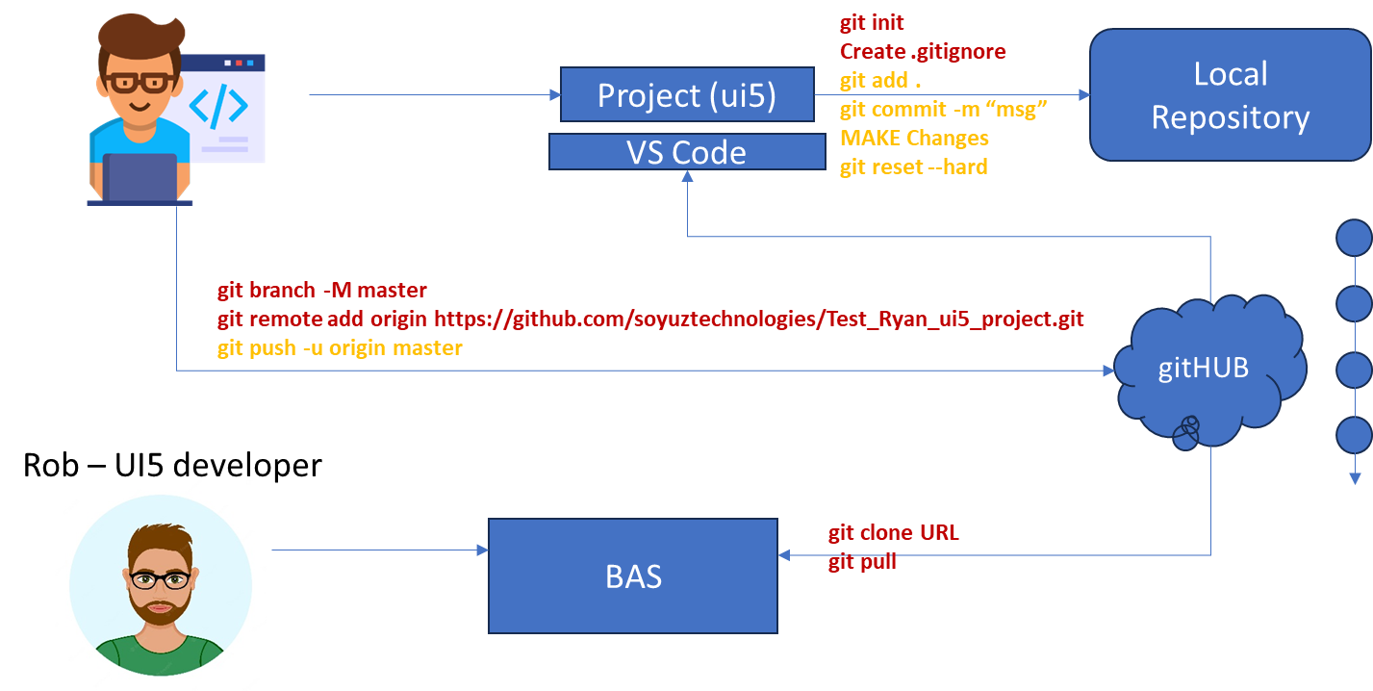






Git and Git HUB

Slide 6
Git
Distributed source code management system for developers to manage any kind of source code. Its open source and free, already integrated with BAS tool. You need to install git in local machine if you using VS code.
https://git-scm.com/

Slide 7
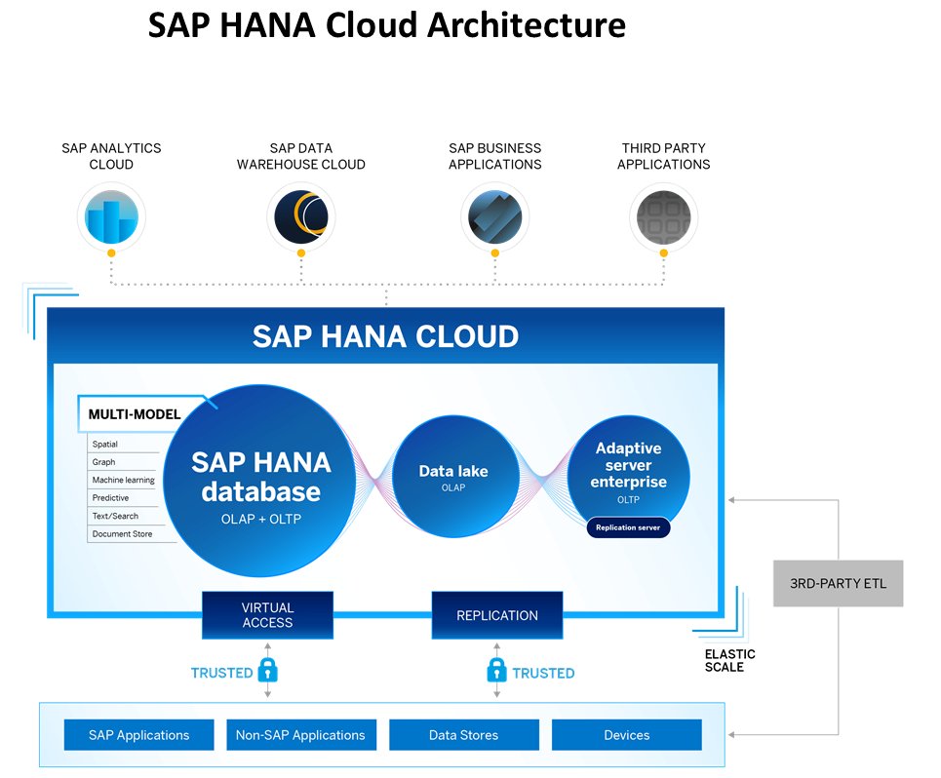
Introduction to HANA Cloud
SAP HANA Cloud is a fully managed, in-memory, cloud database as a service (DBaaS). It is the cloud-based data foundation for SAP Business Technology Platform. With SAP HANA Cloud you can create, run, and extend new and existing applications.
SAP HANA Cloud includes a number of software components. The core component is SAP HANA Database, but other components can be added at any time, such as a data lake.
Key Components of SAP HANA Cloud
There are four key components of SAP HANA Cloud:
SAP HANA Cloud, SAP HANA Database
In-memory database with built-in advanced analytics (spatial, graph, text, etc.)
SAP HANA Cloud, data lake
Store and query large data sets and most file types
SAP HANA Cloud, adaptive server enterprise
Support for extreme –performance transactional applications
SAP HANA Cloud, adaptive server enterprise replication
Bi-directional real time data replication across databases

Slide 8
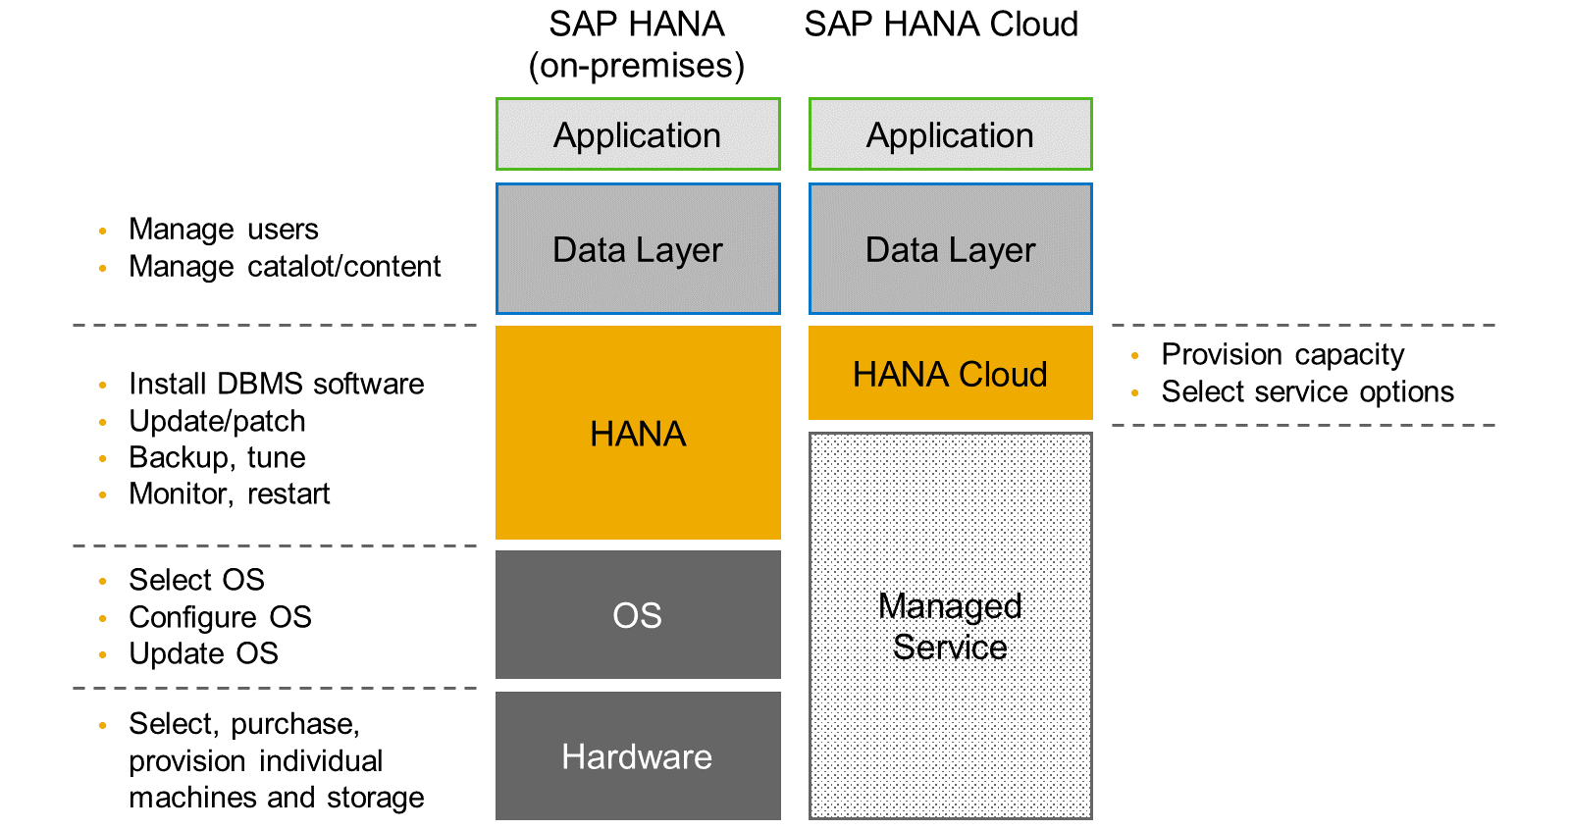
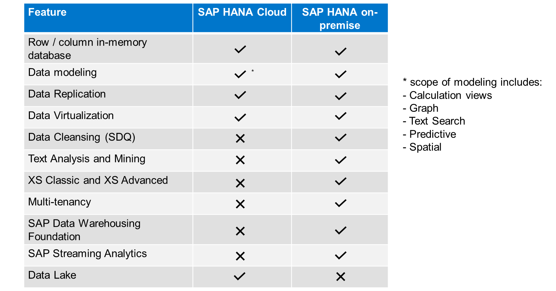
HANA Cloud v/s On-premise
Feature Differences
SAP HANA Cloud compares very closely with SAP HANA on-premise in terms of features but there are some differences.

Slide 9
What is Schema in HANA
Schema – Is a mandatory database object of database which stores other database objects.
It’s a logical separation of database objects.
It is home of all the runtime object
Security
BW
ekko
ECC
ekko
S/4HANA
ekko
Non-SAP
SAP HANA 600GB
SCBW
ekko
ECC001
ekko
SAPS4C
ekko
MIG
ekko
SYS

Slide 10
HDI Container
An HDI Container is also a schema. But it is managed differently from a normal schema.
Schema -- How its created?
Manually create it in BTP
Application Managed HDI Container (You as developer ONLY work with App, App will talk to HANA to create and manage this schema to store/read data internally)
You cant access HDI Container using HANA Studio (Deprecated tool), We can use new SAP HANA Database Explorer, SAP HANA WebIDE for OP or BAS to access HDI Container.
HDI -- Who creates it?
There is a new service in SAP HANA called SAP HDI (HANA Deployer Infrastructure) which is just a microservice responsible to managing the container. HDI Deployer is a component which is used to talk to this service from our app.

Slide 11
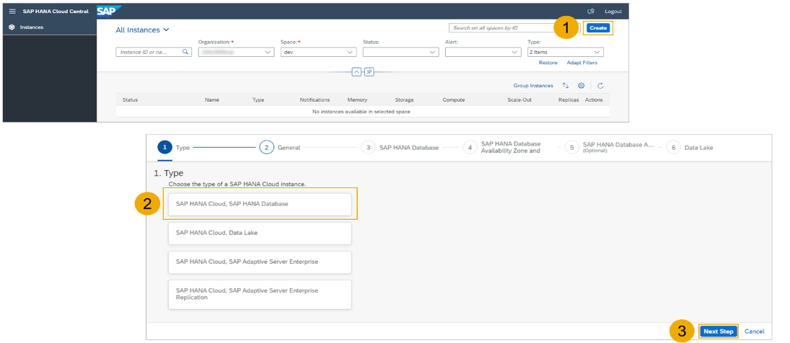
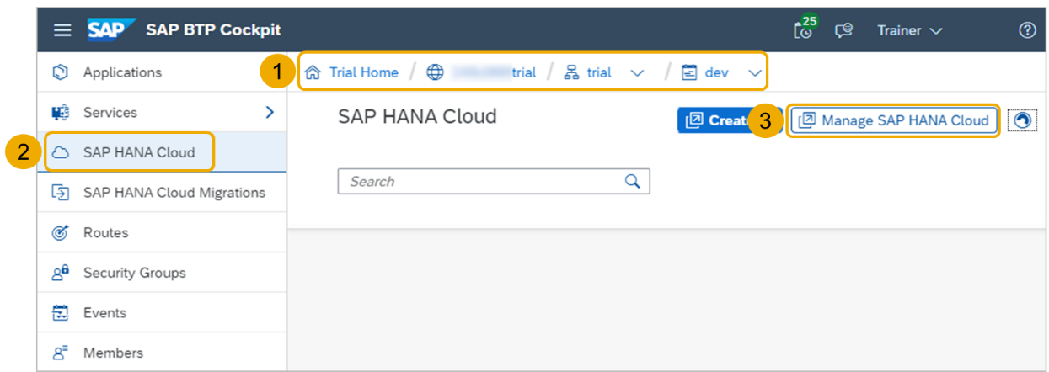
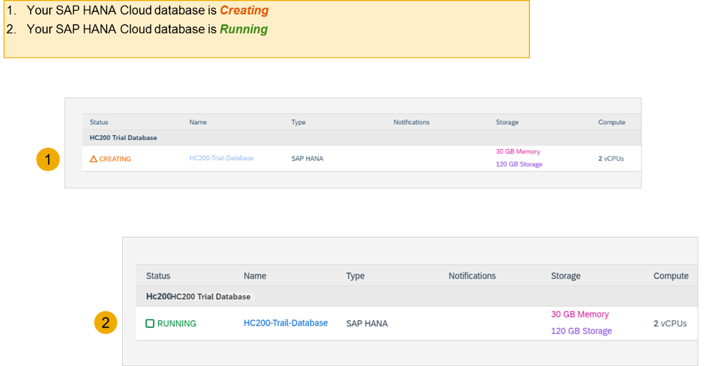
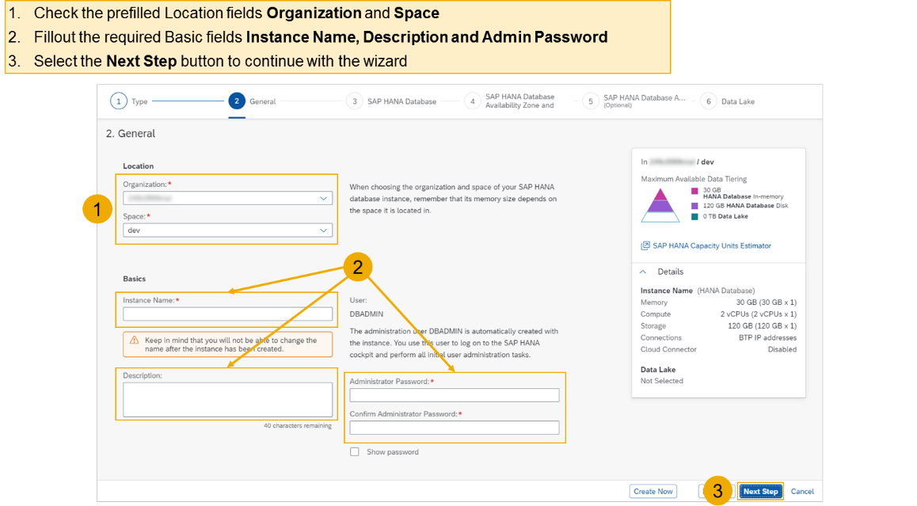
Hands on - Create HANA Cloud Instance
Login to your trial and navigate to your dev space
Select SAP HANA Cloud
Select the Manage SAP HANA Cloud button to start the SAP HANA Cloud Central
Select the Create button to start the wizard
Select the SAP HANA Cloud instance Type to create
Select the Next Step button to continue

Slide 12
HDI Container
An HDI Container is also a schema. But it is managed differently from a normal schema.
Schema -- How its created?
Manually create it in BTP
Application Managed HDI Container (You as developer ONLY work with App, App will talk to HANA to create and manage this schema to store/read data internally)
You cant access HDI Container using HANA Studio (Deprecated tool), We can use new SAP HANA Database Explorer, SAP HANA WebIDE for OP or BAS to access HDI Container.
HDI -- Who creates it?
There is a new service in SAP HANA called SAP HDI (HANA Deployer Infrastructure) which is just a microservice responsible to managing the container. HDI Deployer is a component which is used to talk to this service from our app.

Slide 13
Hands on - Create HANA Cloud Instance
Login to your trial and navigate to your dev space
Select SAP HANA Cloud
Select the Manage SAP HANA Cloud button to start the SAP HANA Cloud Central
Select the Create button to start the wizard
Select the SAP HANA Cloud instance Type to create
Select the Next Step button to continue

Slide 14

































Design time
prod

Slide 15

What We Did
Let’s Summarize

Slide 16

www.anubhavtrainings.com
Thank You
End of Day 6

Slide 17


We’re committed to empower you to be
#FutureReady
through powerful training solutions.
We build the workforce of the future.
260+
Corporate Clients
60,000+
Learners Trained
26000+
Learners Placed
FREE WEBINARS
Sign up for free webinars with industry experts every fortnight!
Enroll Now!
Contact us today!
https://anubhavtrainings.com

